Slide 1
Big Data: Data Lakes and Data Oceans Workshop
Lex Crosett, Principal Solutions Architect
Sajee Mathew, Principal Solutions Architect
Erick Dame, Enterprise Solutions Architect
John Mallory, Business Development Manager

Slide 2
Data Lake Foundation Lab Overview
The lab will take ~30 minutes to deploy
We will launch the lab soon
Apply $25 credit
Delete all resources at the end of this workshop
Delete CloudFormation stack and it will clean up
But first, an intro to the lab
Notes:
Issue $25 credit – distributing at the end as you leave.
Use your own AWS account – make sure that you don’t have a permissions problem if you are using a corporate AWS account
Spend 30 minutes on Data Lake concept review
Use an existing solution to set up Data Lake and get tools ready
Add information to a Data Lake

Slide 3
Lab overview
Data submission, including batch submissions to Amazon S3 and streaming submissions via Amazon Kinesis Firehose.
Ingest processing, including data validation, metadata extraction, and indexing via Amazon S3 events, Amazon Simple Notification Service (Amazon SNS), AWS Lambda, Amazon Kinesis Analytics, and Amazon ES.
Dataset management through Amazon Redshift transformations and Kinesis Analytics.

Slide 4
Lab overview
Data transformation, aggregation, and analysis through Amazon Athena and Amazon Redshift Spectrum.
Search, by indexing metadata in Amazon ES and exposing it through Kibana dashboards.
Publishing into an S3 bucket for use by visualization tools.
Visualization with Amazon QuickSight.

Slide 5
Data Lake Usage Model

Slide 6
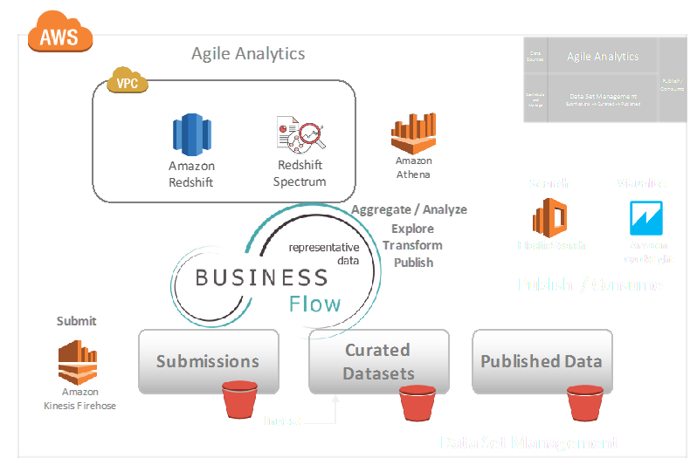
Capabilities and solution components

Slide 7
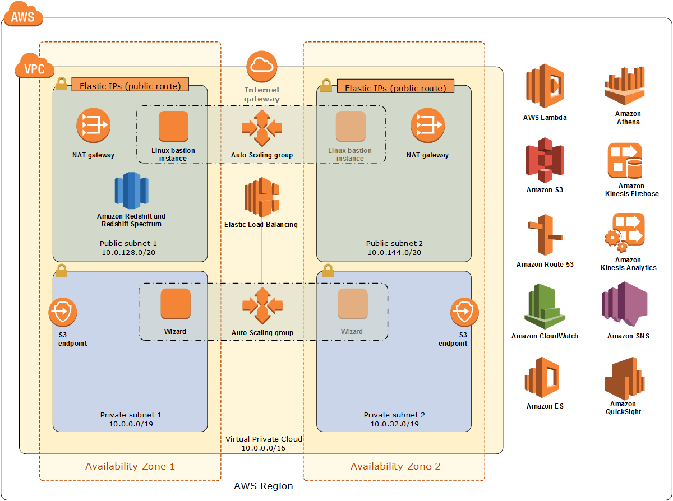
Architecture

Slide 8
Process Flow

Slide 9
Sample Dataset

Slide 10
Start Lab

Slide 11
Delete the stack
Terminate all of the resources created by the deployment
Add screenshot here

Slide 12
Workshop Process
Log in to your AWS account
Apply account credit
Open the workshop guide
Find and run the Data Lake Foundation on AWS
Once complete, load the Behavioral Risk Factor Surveillance system (BRFSS) data into S3 following the workshop instructions
Follow the analysis steps in the workshop guide
Run Delete Stack to remove resources when done

Slide 13
Questions?

